Slide 1
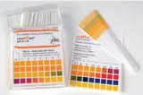
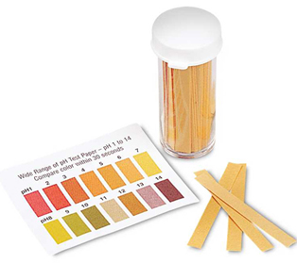
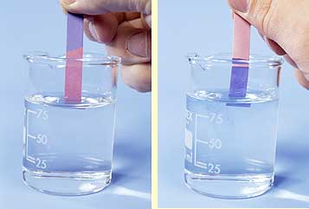
Acids, Bases, and Salts

Slide 2
The pH Scale
The pH scale measures the ratio of hydrogen-based ions produced in solution (in water).
2H₂O → OH⁻ + H₃O⁺
Water molecules dissociate into hydroxide anions (OH⁻) and hydronium cations (H₃O⁺)

Slide 3
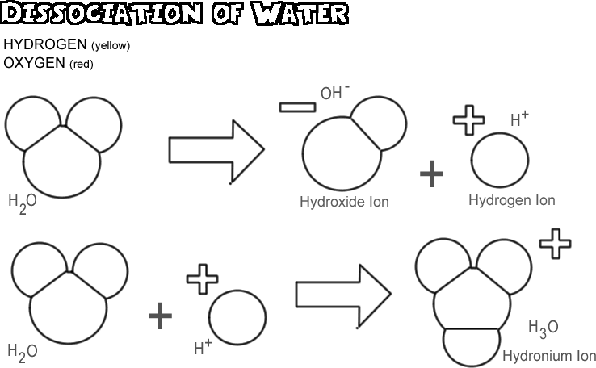
H
H
H
O
O
H
H
H
H
H
H
H

Slide 4
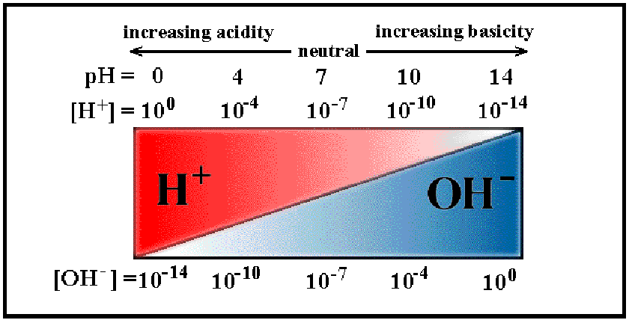
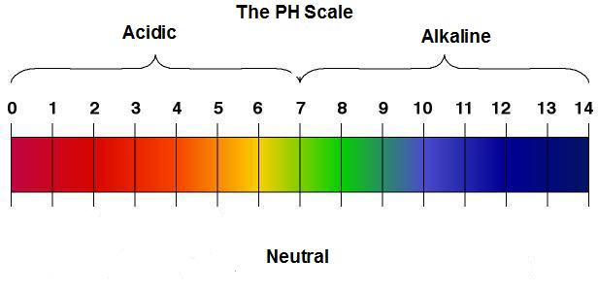
The pH Scale
NEUTRAL solutions have an equal amount of hydroxide and hydronium ions
ACIDIC solutions contain more hydronium (H₃O⁺) ions
BASIC (alkaline) solutions contain more hydroxide (OH⁻) ions

Slide 5
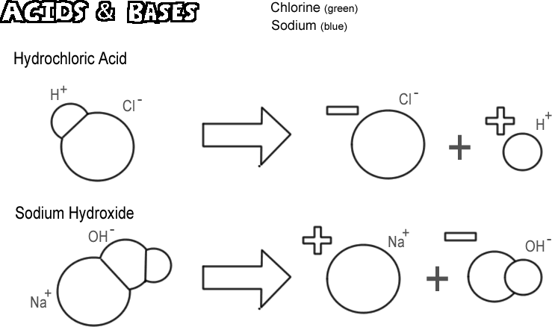
H
Cl
Cl
H
O
H
Na
O
H
Na

Slide 6
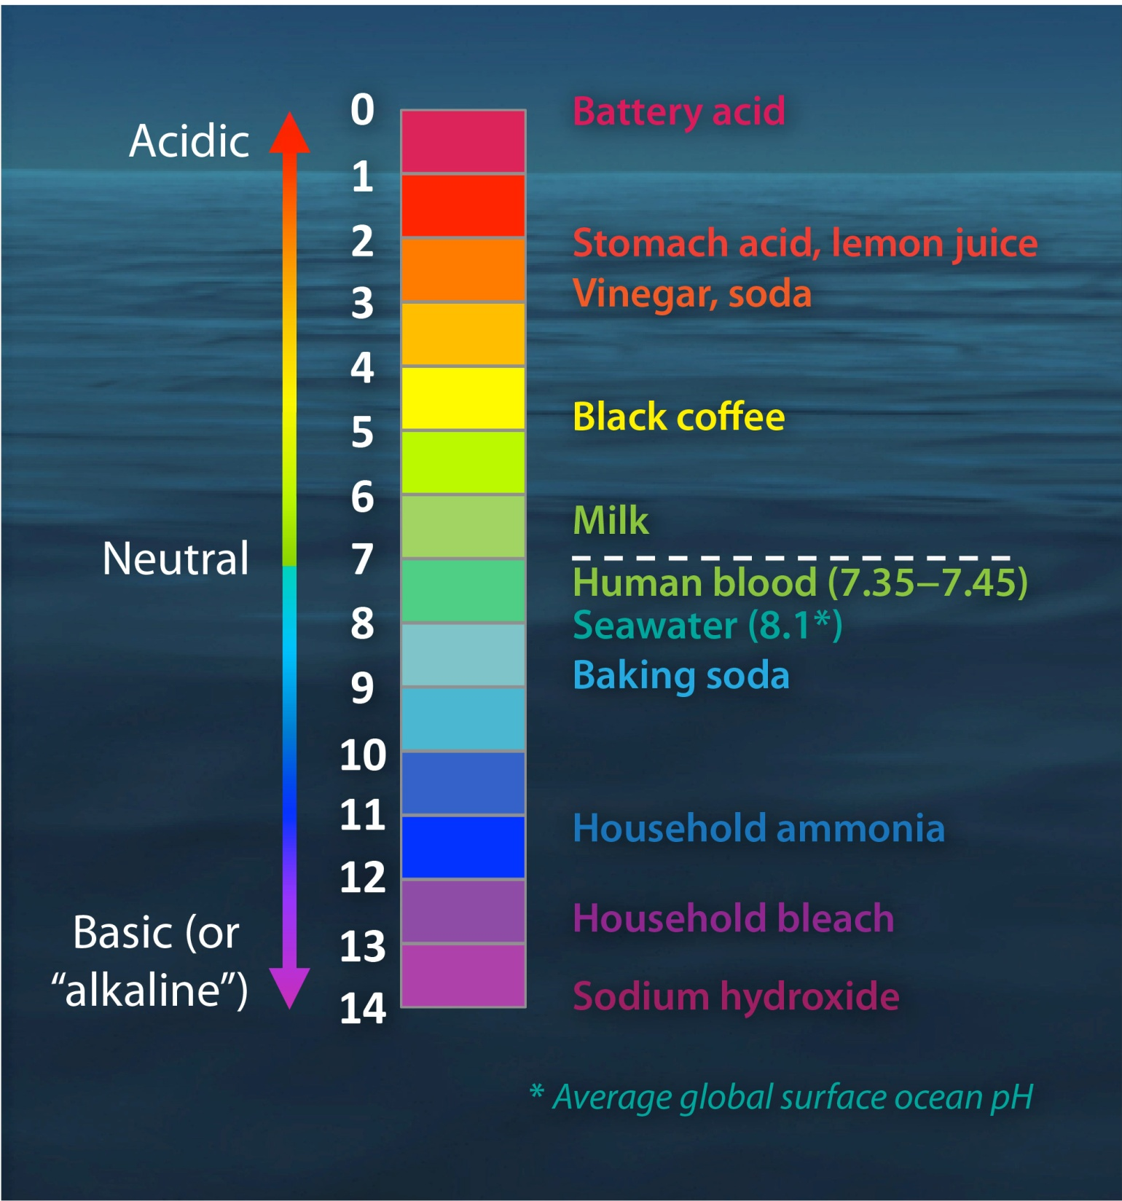
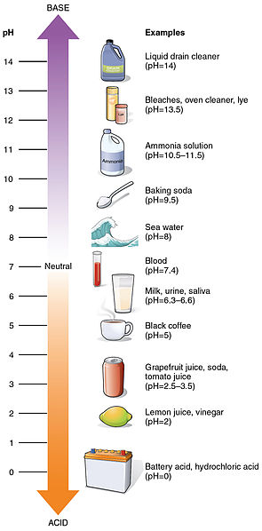

Slide 7
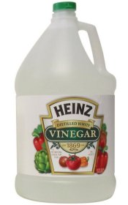
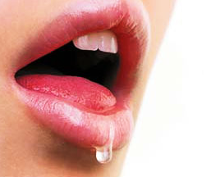
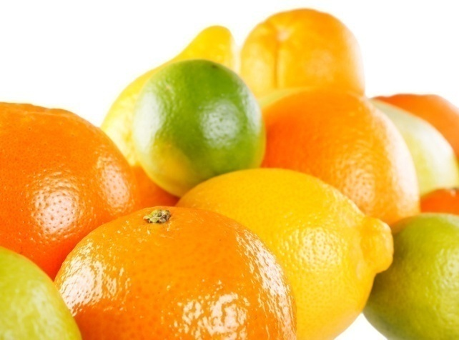
Acids
Solutions that produce hydronium ions (H₃O⁺) in water
Stronger acids produce more H₃O⁺ ions in solution
0-7 on the pH scale
Common Acids:
Vinegar, soda
citrus
saliva

Slide 8
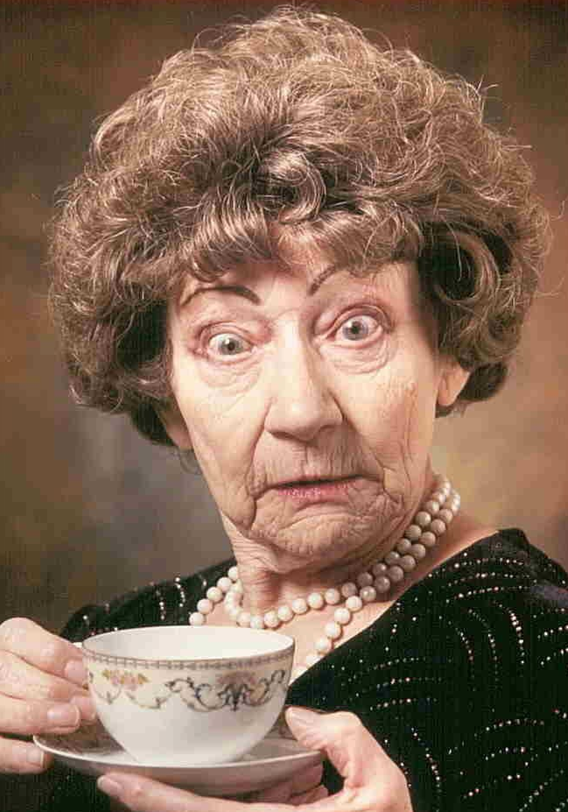
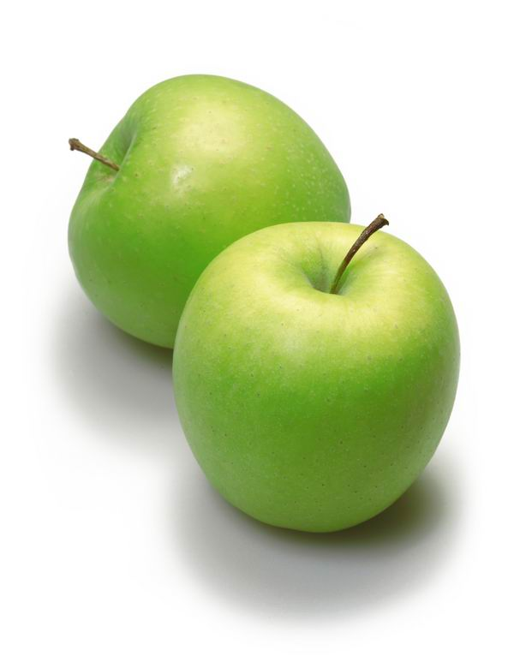
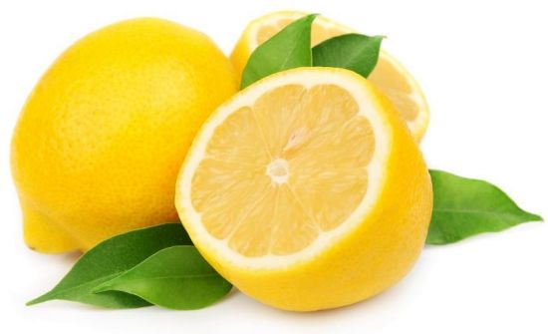
Properties of Acids
Sour taste
Citrus (oranges, grapefruits, lemons) – citric acid
Other fruits (cherries, tomatoes, apples)
Vinegar, tea, spoiled milk
Many acids are unsafe, so DON’T taste something to see if it is acidic!!!

Slide 9
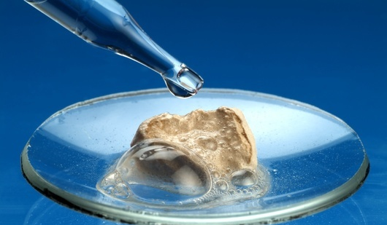
Properties of Acids
React with metals and carbonates
Produce hydrogen gas bubbles
Can be corrosive (eat away at other materials)
Used to make etchings or identify limestone

Slide 10
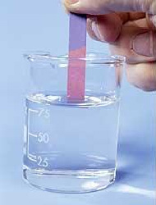
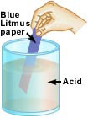
Properties of Acids
Turns blue litmus paper red
A compound in the paper changes color when it comes in contact with an acid

Slide 11
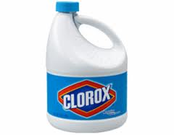
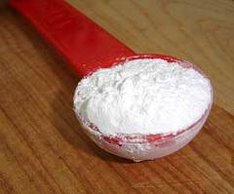
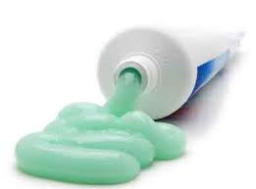
Bases
Solutions that produce hydroxide ions (OH⁻) in water
Stronger bases produce more OH⁻ ions
7-14 on the pH scale
Common Bases
Baking powder
toothpaste
bleach

Slide 12
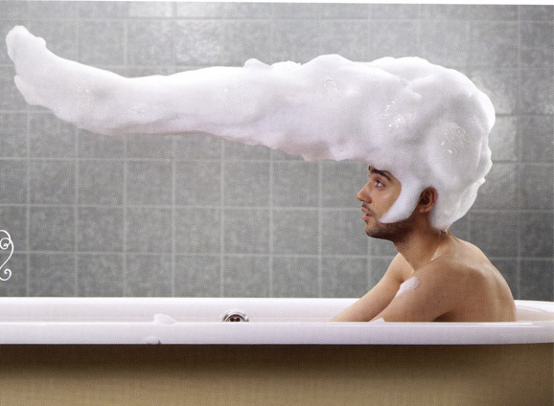
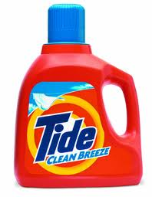
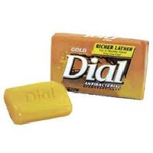
Properties of Bases
Bitter Taste
Soap, Shampoo, Detergent
Many bases are unsafe, so do not taste something to see if it is a base!!!

Slide 13
Properties of Bases
Slippery feel
When washing your hands, the soap makes your skin slippery
Strong bases can irritate or burn your skin

Slide 14
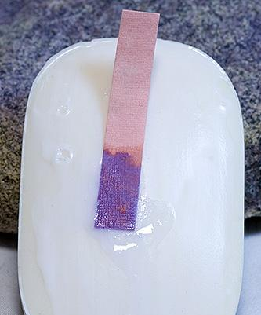
Properties of Bases
Turns red litmus paper blue
A compound in the paper changes color when it comes in contact with a base

Slide 15
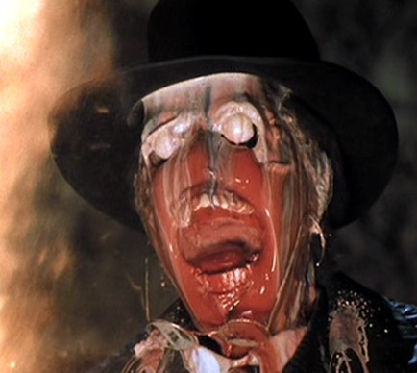
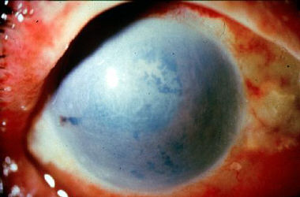
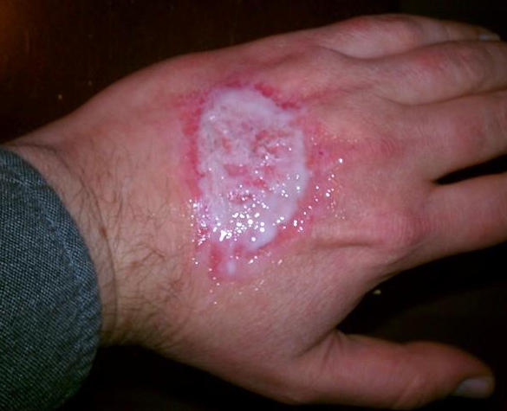
Danger!
Both acids and bases can irritate your skin/eyes.
Strong acids and bases can cause chemical burns!
Chemical burns from bases are more common (more prevalent in cleaning products) and often more severe.

Slide 16
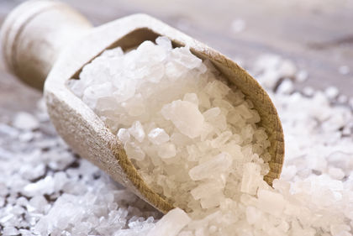
Salts
Ionic compounds resulting from a neutralization reaction between an acid and a base.
Ex: HCl + NaOH → NaCl + H₂O
hydrochloric acid + sodium hydroxide → sodium chloride (salt) + water
often exothermic (not always)
frequently, water is a product along with the salt
do NOT necessarily result in a pH of 7
depends on the relative strength of acid and base

Slide 17
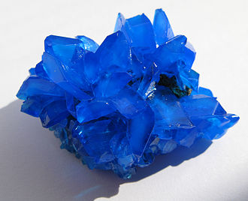
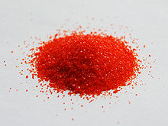
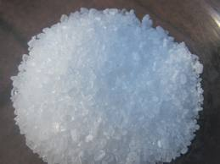
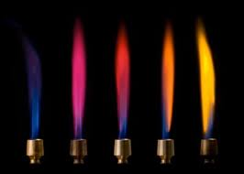
Properties of Salts
Salts occur in a variety of colors
and burn in a variety of colors!

Slide 18
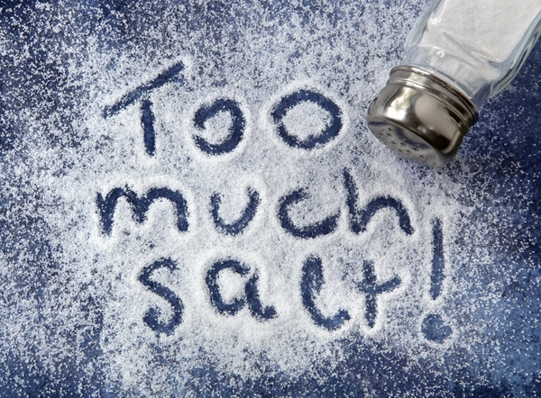
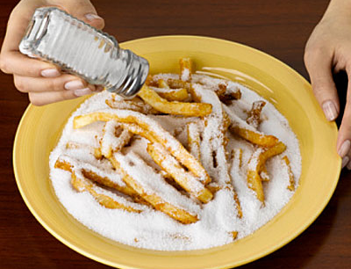
Properties of Salts
Salts can taste:
Salty
Sweet
Sour
Bitter
Savory

Slide 19
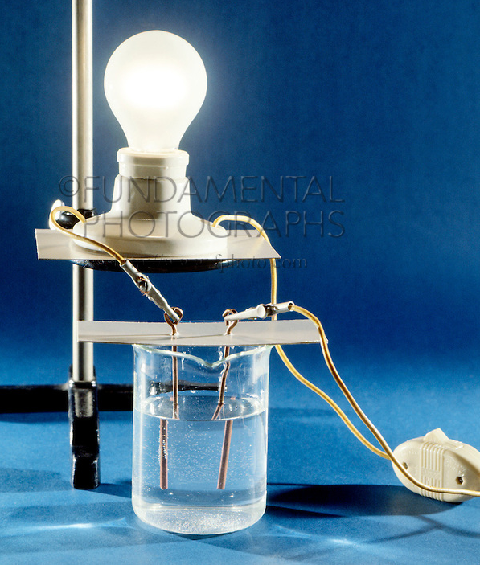
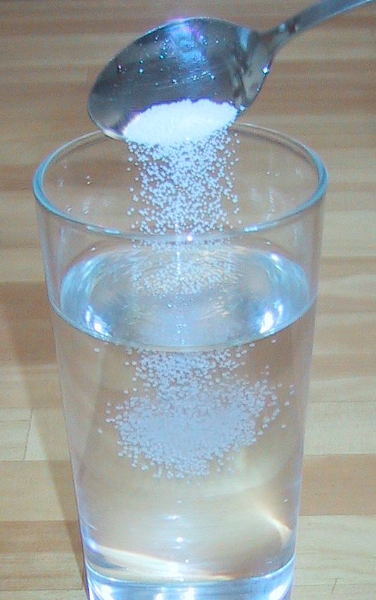
Properties of Salts
Salts are electrically neutral
However, when dissolved in water, salts can conduct electricity

