Slide 1
IDEAL GAS BEHAVIOR
THE IDEAL GAS LAW

Slide 2
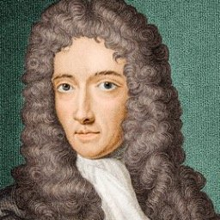
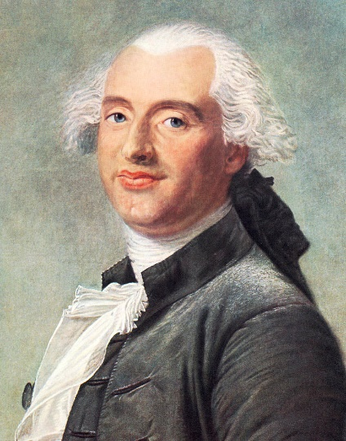
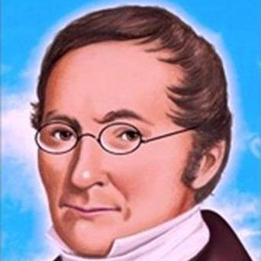
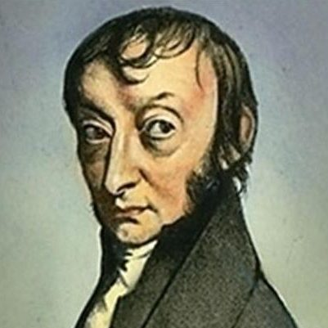
IDEAL GAS BEHAVIOR
There are a series of scientific laws that describe the behavior of a gas under “ideal” conditions (ie – not near its condensation point)
Boyle’s Law
Charles’s Law
Gay-Lussac’s Law
Avagadro’s Law

Slide 3
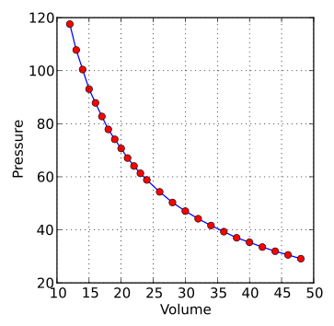
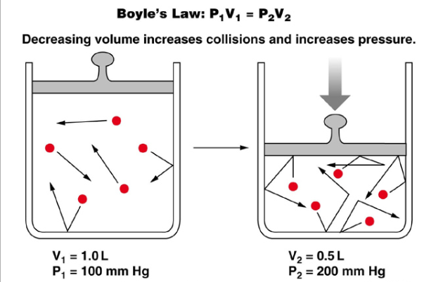
BOYLE’S LAW
For a fixed amount of an ideal gas at a fixed temperature, the pressure and volume are inversely proportional.
Pressure and volume have an inverse relationship when temperature is constant.
This can be stated several ways mathematically:

Slide 4
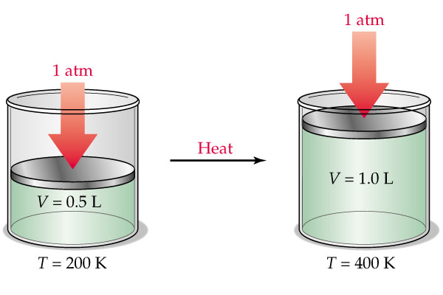
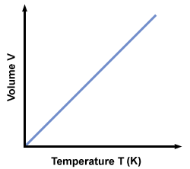
CHARLES’S LAW
Under constant pressure, the TEMPERATURE and the VOLUME of an ideal gas are directly proportional.
Describes how gasses tend to expand when heated.
This can be stated several ways mathematically:

Slide 5
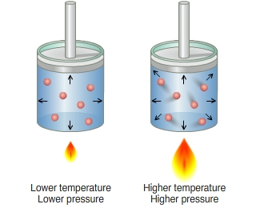
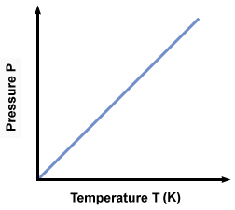
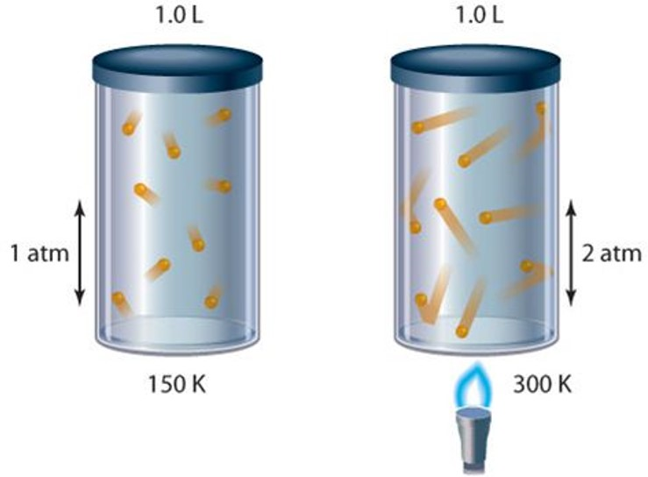
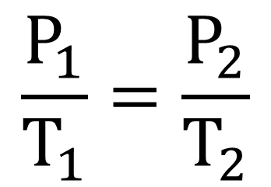
GAY-LUSSAC’S LAW
For a given mass and constant volume of ideal gas, the pressure exerted on the sides of its container is directly proportional to its absolute temperature.
The pressure exerted by a fixed volume of gas is directly related to its temperature.
This can be stated several ways mathematically:

Slide 7
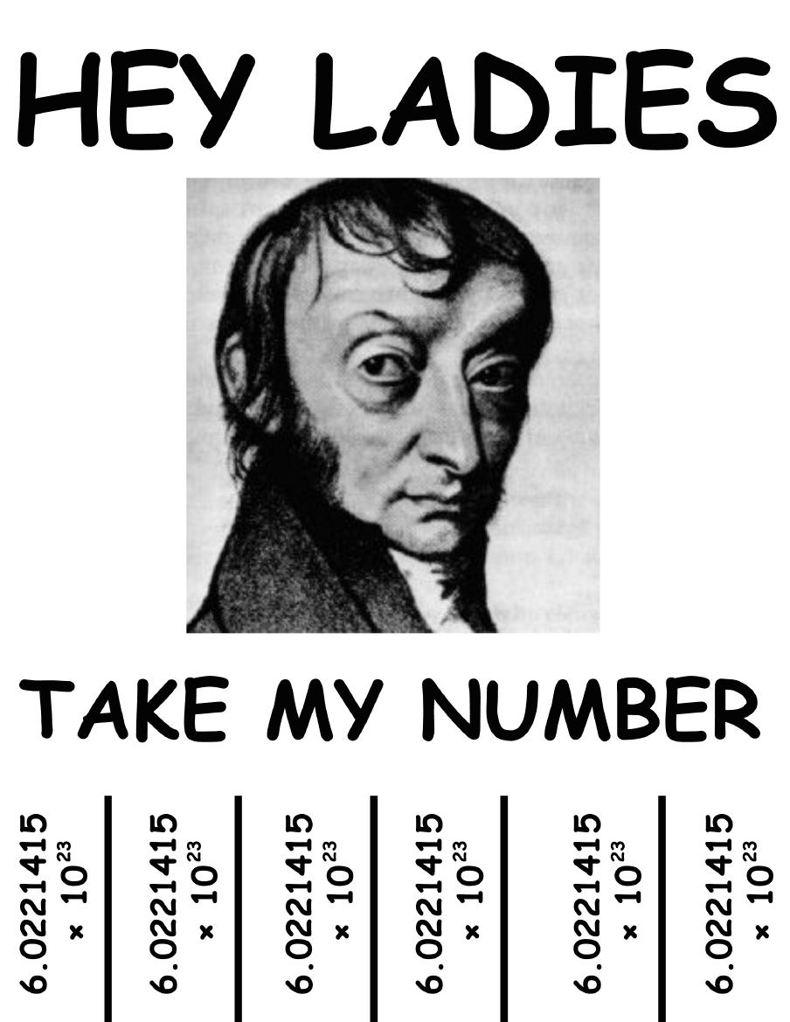
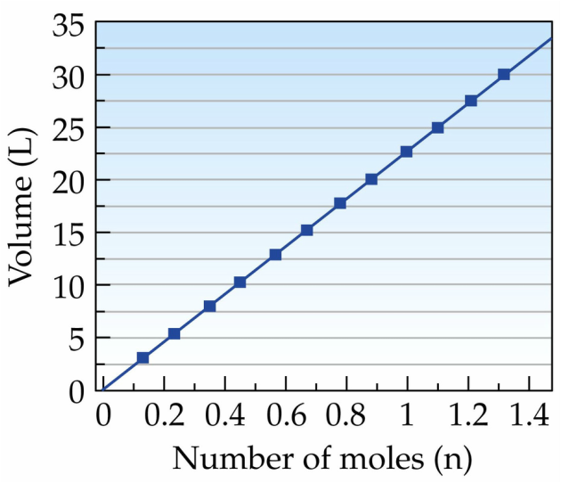
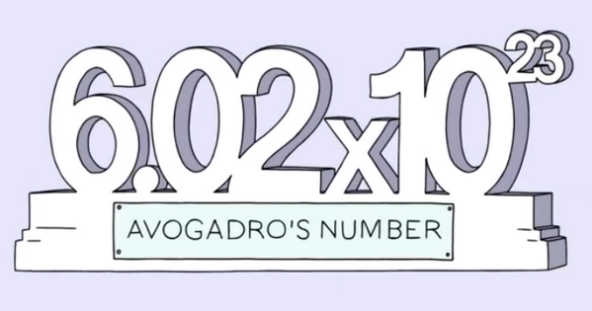
AVAGADRO’S LAW
The volume occupied by an ideal gas is directly proportional to the number of molecules of the gas present in the container.
The volume and amount of gas are directly proportional.
This can be stated several ways mathematically:

Slide 8
THE IDEAL GAS LAW
a combination of the laws that describe the behavior of ideal gasses
BOYLE’S LAW – PRESSURE is inversely proportional to VOLUME
CHARLES’S LAW – TEMPERATURE is directly proportional to VOLUME
GAY-LUSSAC’S LAW – PRESSURE is directly proportional to TEMPERATURE
AVAGADRO’S LAW – VOLUME is directly proportional to the AMOUNT

Slide 9
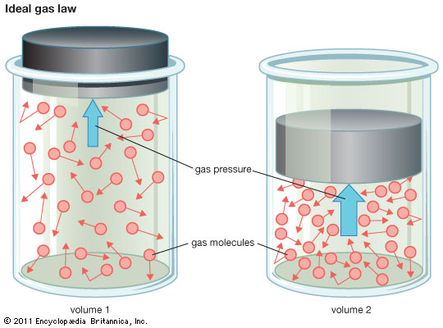
THE IDEAL GAS LAW
The product of the PRESSURE and the VOLUME of an ideal gas will equal the product of the AMOUNT of gas, the GAS CONSTANT, and the TEMPERATURE of the gas
In other words…
PV=nRT
P = pressure
V = volume
n = amount of gas (# of atoms/molecules)
R = gas constant (a constant value derived from research)
T = temperature

Slide 10
PV = nRT Conceptually…
Let’s remove “nR” from the equation, since they are constants (for each sample) and we are only concerned with a conceptual understanding (not actual numbers).
This leaves us with: PV = T
Both PRESSURE and VOLUME are directly proportional to TEMPERATURE
When P rises, so does T (same V); When T rises, so does V (same P)
PRESSURE and VOLUME are inversely proportional to each other
When V increases, P decreases

