Slide 1
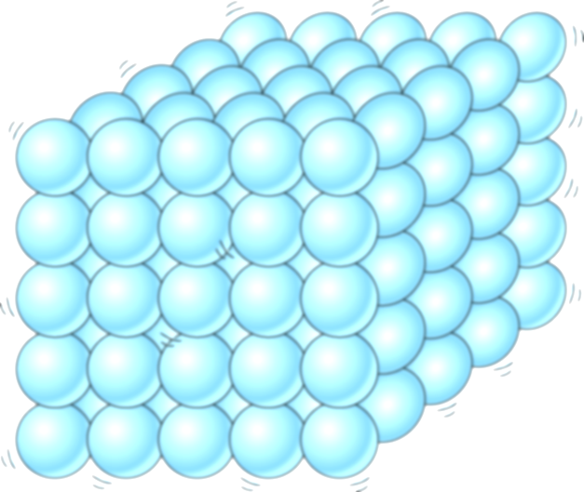
Particle Diagrams
STATES OF MATTER

Slide 2
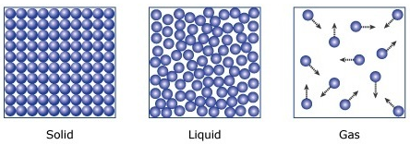
POSITIVES
Gas shows motion
NEGATIVES
Fails to show motion of solid or liquid particles
Fails to maintain number of particles
May cause misconceptions about volume (all 3 fill the container)

Slide 3
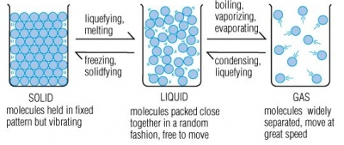
POSITIVES
Shows particle motion
NEGATIVES
May cause misconceptions about shape and volume (all 3 fill container)
Fails to maintain number of particles

Slide 4
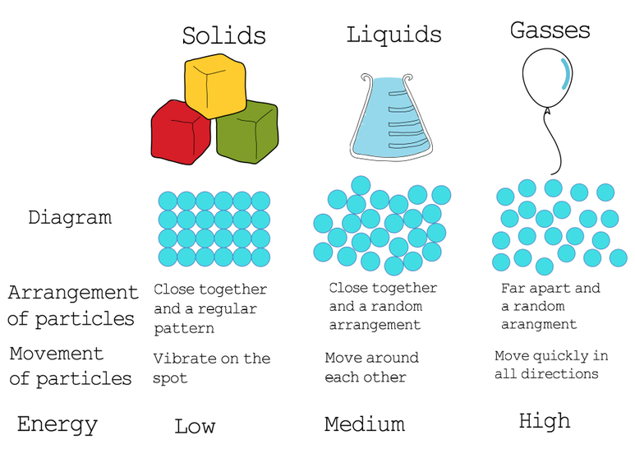

Slide 5
POSITIVES
Relates to real-world objects/substances
Discusses particle arrangement and motion/energy
NEGATIVES
Fails to show particle motion
Fails to maintain number of particles

Slide 6
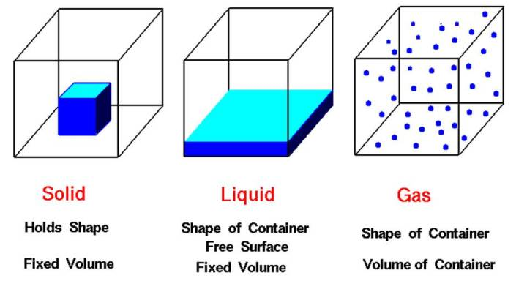
POSTIVES
Shows shape and volume well (3 dimensional!)
Discusses shape and volume
NEGATIVES
Fails to show particles in solid and liquid
Fails to illustrate particle motion

Slide 7
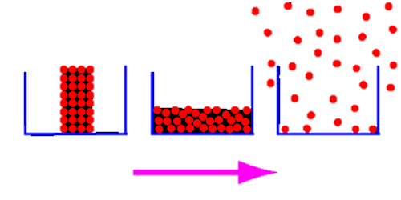
POSITVES
Shows shape and volume well (especially for gas)
Maintains number of particles
NEGATIVES
Fails to show particle motion

Slide 8
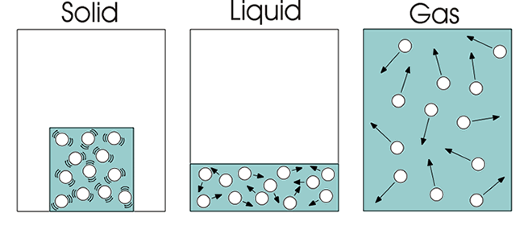
POSTIVES
Shows particle motion
Shows shape and volume well
Maintains number of particles
NEGATIVES
?

Slide 9
PHET Simulator

Slide 10
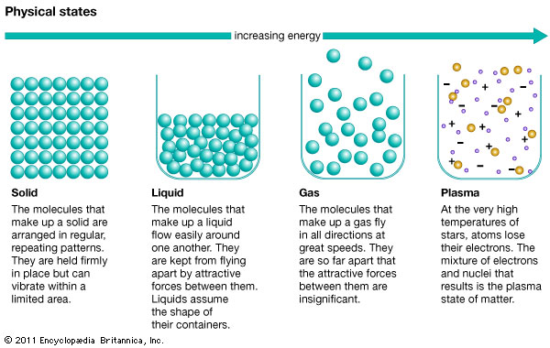

Slide 11
POSTIVES
Shows shape and volume well
Includes plasma
Describes particle arrangement and motion
Discusses/shows energy
NEGATIVES
Fails to illustrate particle motion
Fails to maintain number of particles

Slide 12
POSTIVES
Shows shape
Shows solid structure
Includes plasma
Illustrates energy (“heat”)
NEGATIVES
Fails to show particle motion
Fails to maintain number of particles
May cause misconceptions about density
Some are shown in 3D but some are not

Slide 13
ASSIGNMENT: States of Matter Diagram
Illustrate your own states of matter particle diagram.
Include as many positive characteristics as you can
Illustrate shape/volume
Maintain number of particles
Illustrate particle motion
Include energy
Limit negative characteristics as much as possible
Avoid things that may cause misconceptions

