Slide 1
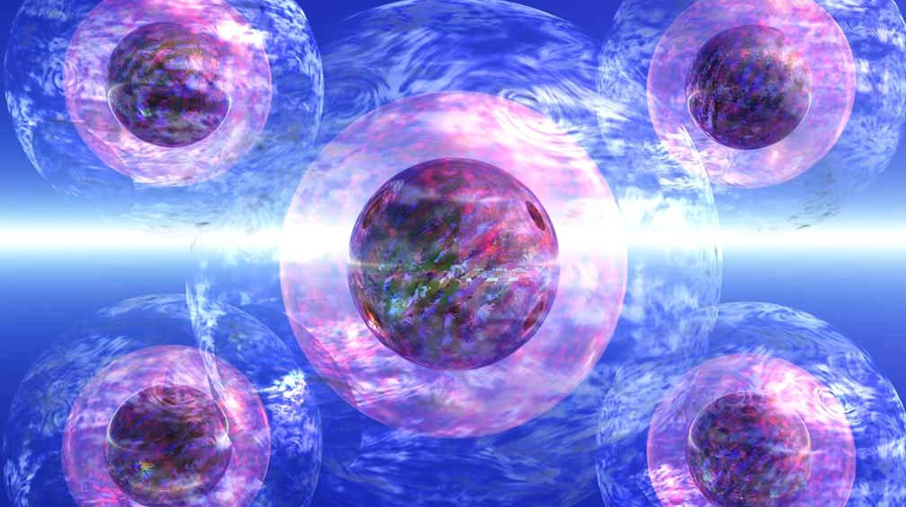
Atomic Theory

Slide 2
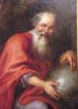
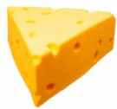
Origin
The earliest recorded idea about the existence of atoms comes from a Greek philosopher named Democritus @400 BC
He theorized that if you were to cut an object in half, then cut it in half again and again over and over…
Eventually you would be left with something too small to cut any more.
This would represent the smallest individual unit of matter.
He gave it the name, “ATOMOS,” which means UNCUTTABLE.

Slide 3
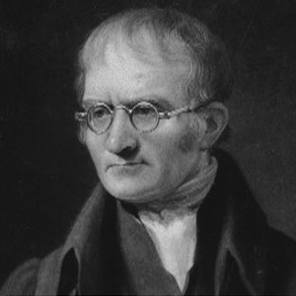
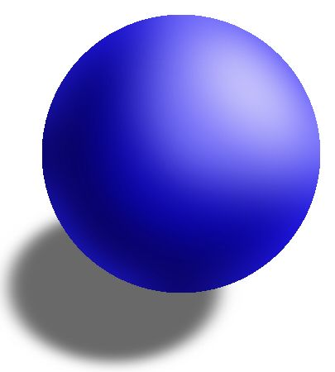
Atomic Theory
An Englishman named John Dalton is credited with developing the first modern ideas about atoms in 1808:
All matter is composed of atoms.
The “building blocks of the universe”
Atoms of each element are the same size, mass, etc., but are different from atoms of other elements.
Each element has a unique type of atom
Atoms can’t be subdivided (cut) or destroyed.
Atoms are the smallest individual unit of matter
Has since been falsified by evidence (nuclear reactions)

Slide 4
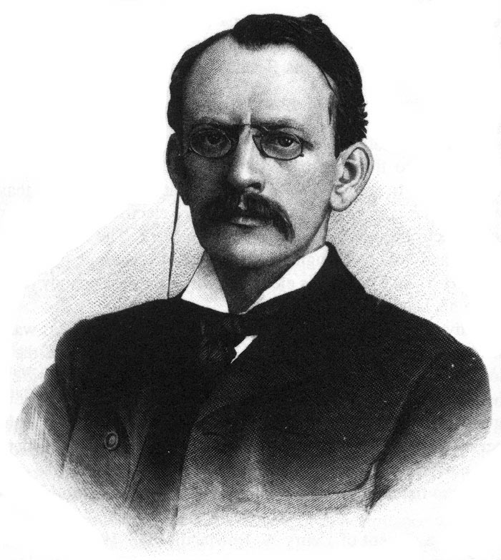
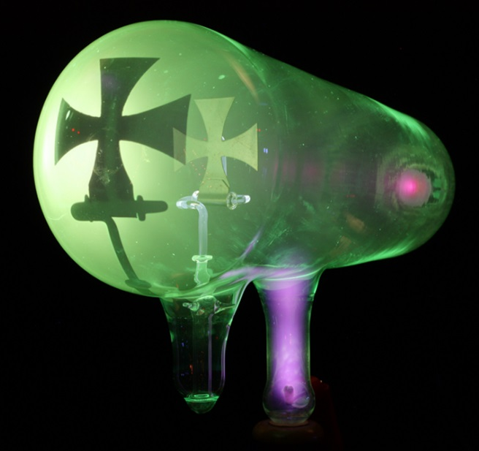
Electrons
Tiny negatively charged particles that surround the nucleus (charge = -1)
Discovered in 1897
J.J. Thomson placed a magnet near a cathode ray tube and bent the beam of particles.
Originally called, “corpuscles”…

Slide 5
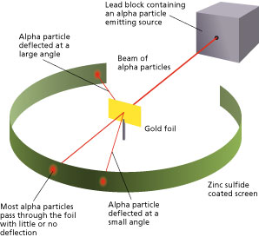
Nucleus
First proposed in 1904 by Japanese physicist, Hantaro Nagaoka
Evidence provided by Ernest Rutherford in 1911
Shot positively charged alpha particles at thin gold foil and some bounced back.
He concluded that the particles that bounced back had collided with a dense, positively charged nucleus.

Slide 6
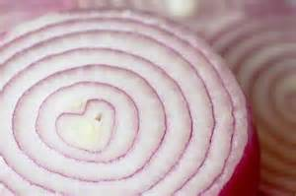
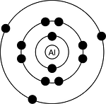
Valence Electrons
Electrons are more likely to reside in certain areas of the electron cloud.
Different areas are referred to as energy levels
Think of these as concentric “shells”
Proposed by Niels Bohr as a way to explain the behavior of atoms
VALENCE ELECTRONS are electrons that reside on the outer “shell” of the atom.
They determine chemical bonds

Slide 7
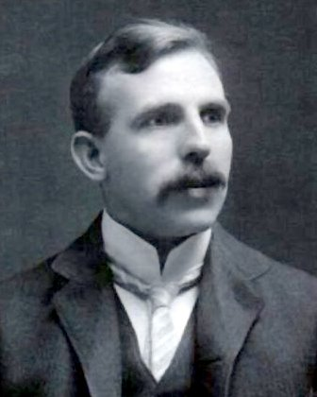
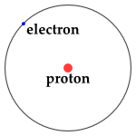
Protons
Positively charged particles which reside in the nucleus
Mass = 2000 times greater than the mass of electrons
Charge = +1 (equal but opposite to electrons)
The number of protons in the nucleus is what makes each element unique
“Discovered” by Ernest Rutherford in 1917
Nucleus of a hydrogen atom (alpha particles)

Slide 8
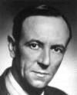
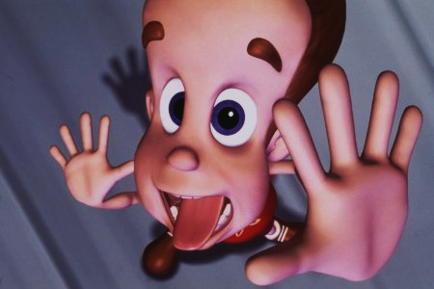
Neutrons
Neutral particles which reside in the nucleus
Mass equal to the mass of a proton
No electrical charge
Discovered by James Chadwick in 1932
Previously, predictions about the masses of atoms were extremely inaccurate based on the mass of the protons only.

Slide 9
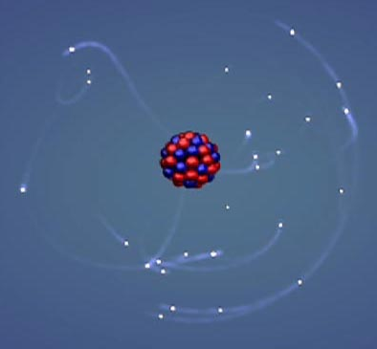
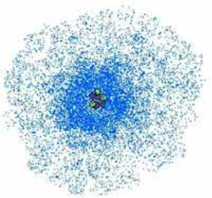
Electron Cloud Model
NUCLEUS
Contains PROTONS and NEUTRONS
Overall positive charge (“+” & “Ø”)
Contains nearly all the mass of the atom
Extremely small and dense
ELECTRON CLOUD
ELECTRONS orbit the nucleus
Contributes almost no mass to the atom
Electrons can only be predicted to be in certain areas based on probability
Most of the atom is empty space

Slide 10
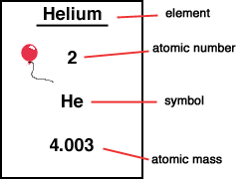
Elements
A Substance made of only one kind of atom
ATOMIC NUMBER
Atoms of each element have a unique number of protons, which differentiates that element from other elements
ATOMIC MASS
The average number of particles in the nucleus (protons & neutrons) for atoms of that element

Slide 11
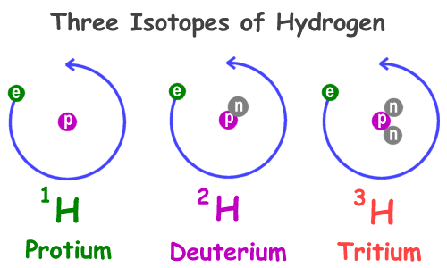
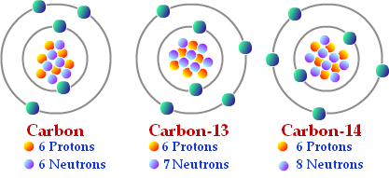
Isotopes
The number of neutrons in an atom can vary without changing the identity of the element
ISOTOPES are atoms of an element with different numbers of neutrons

Slide 12
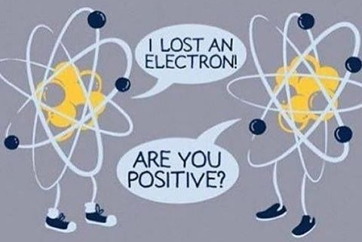
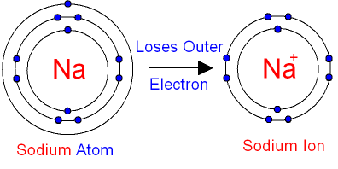
Ions
Imagine a “neutral” atom…
It will have equal numbers of protons (+) and electrons (-)
IONS are atoms that have gained or lost valence electrons and as a result have either a positive (+) or negative (-) charge

Slide 13
What if…
…we start with a neutral atom? | …we change the number of…? | It will result in…
CARBON¹² 6 protons + 6 neutrons Ø 6 electrons - | PROTONS add one proton | New Element NITROGEN 7p⁺ 6n⁰ 6e⁻
 | NEUTRONS add one neutron | Isotope Carbon¹³ 6p⁺ 7n⁰ 6e⁻
 | ELECTRONS add one electron | Ion Carbon⁻ 6p⁺ 6n⁰ 7e⁻

