Slide 1
Mechanical Energy

Slide 2
Mechanical Energy
Energy that an object has due to its motion or position
2 kinds
Kinetic
Potential
Metric Units: Joules (J)

Slide 3
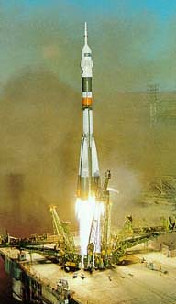
Kinetic Energy
Energy of Motion
“kinetic” means “moving”
Depends on mass and velocity (like speed)
KE = ½ mv² or KE = mv²
2
More mass → more KE
More velocity → more KE
Changing velocity has greater effect because it is squared!
*note: units for mass (kg) and v (m/s)

Slide 4
Kinetic Energy Calculations
A 0.6 kg basketball is thrown at a velocity of 9 m/s. How much Kinetic Energy does it have?
KE = ½ mv²
KE = ½ (0.6 kg)(9 ^{m}/_{s}) ²
KE = ½ (0.6 kg)(81 ^{m2}/_{s2})
KE = ½ (48.6 J)
KE = 24.3 J

Slide 5
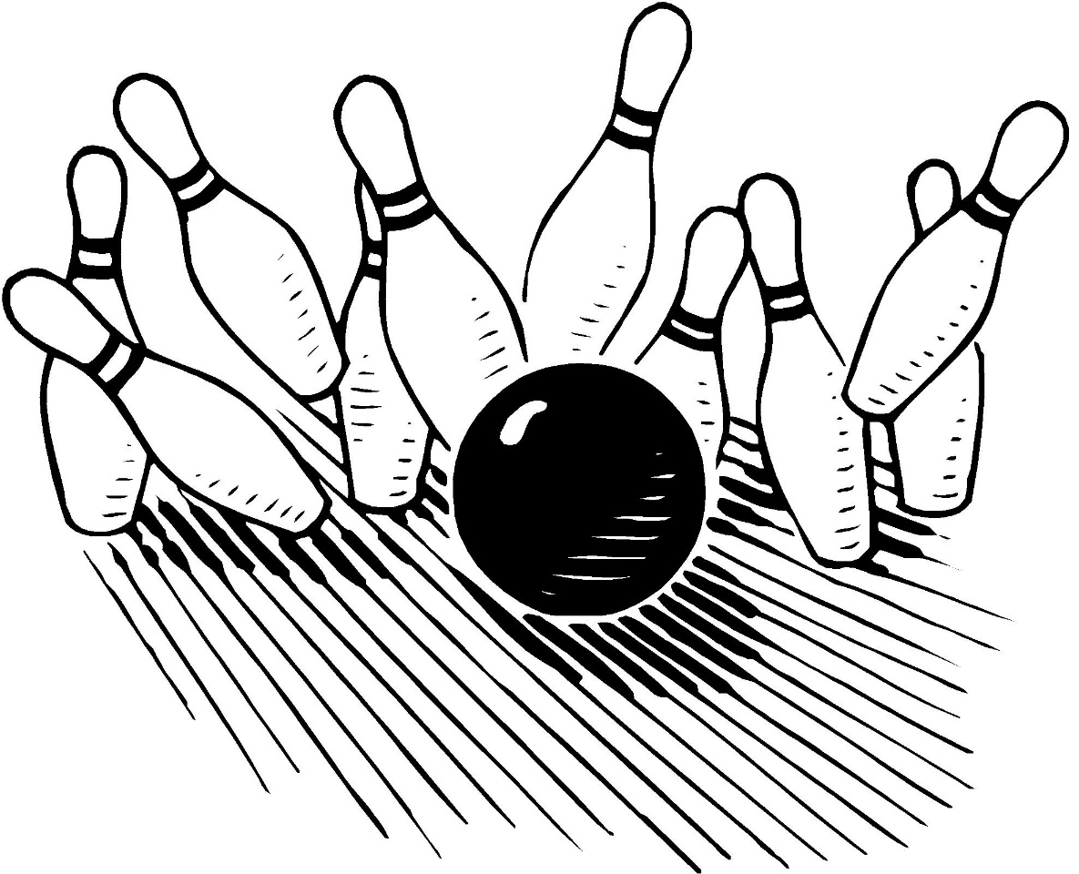
Kinetic Energy Calculations
A 7 kg bowling ball is rolling down the lane with a velocity of 8 m/s. How much Kinetic Energy does it have?
KE = ½ mv²
KE = ½ (7 kg)(8 ^{m}/_{s}) ²
KE = ½ (7 kg)(64 ^{m2}/_{s2})
KE = ½ (448 J)
KE = 224 J

Slide 6
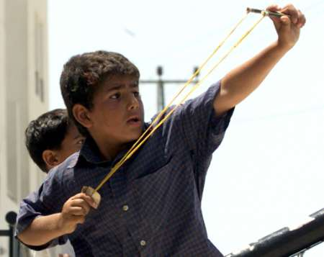
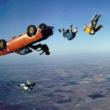
Potential Energy
Stored Energy
Has the “potential” to do work
Elastic Potential
Energy is stored by stretching or compressing
Gravitational Potential
Energy is stored based on height of object

Slide 7
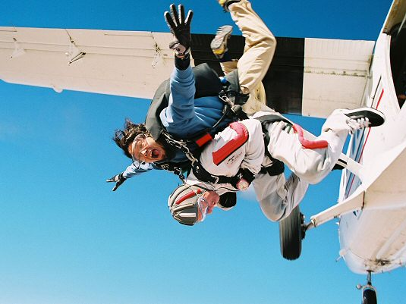
Gravitational Potential Energy
Depends on mass & height
PE = mgh (g = 9.8 m/s²)
Weight = m x g…
PE = Weight x height
Note: The gravitational potential energy of an object is equal to the work done to lift it.
PE = mgh (Height is a distance!)
Work = Fd (Weight (mg) is the Force due to gravity!)

Slide 8
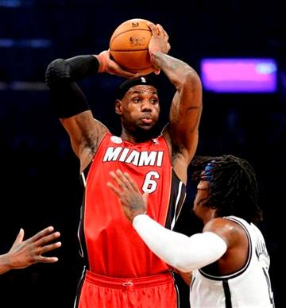
Potential Energy Calculations
A 0.6 kg basketball is held above a player’s head. The ball is 2 m above the ground. How much potential energy does it have?
PE = mgh
PE = (0.6 kg)(9.8 m/s²)(2 m)
PE = (5.88 N)(2 m)
PE = 11.76 J

Slide 9
Potential Energy Calculations
A 1.0 kg textbook is placed on a shelf 1.5 m above the ground. How much potential energy does it have?
PE = mgh
PE = (1 kg)(9.8 m/s²)(1.5 m)
PE = 14.7 J

Slide 10
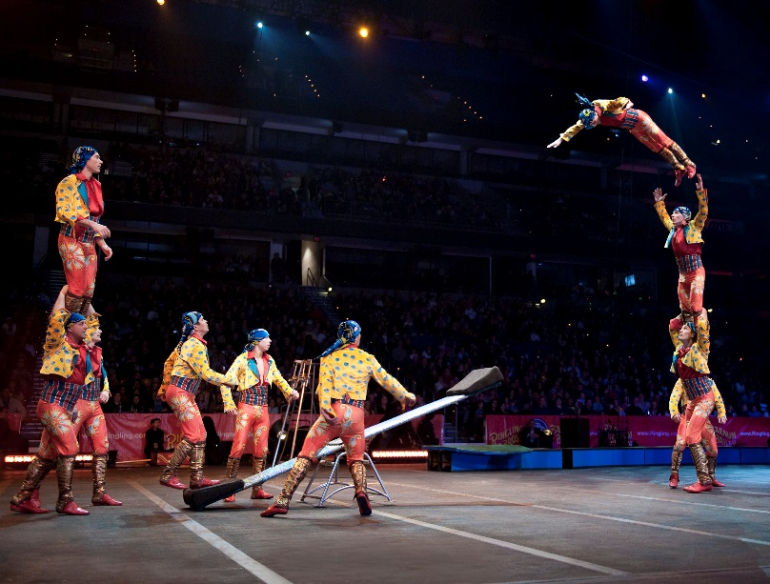
Mechanical Energy Conversions
Visualize the mechanical energy lab with the teeter boards.
What type of mechanical energy did the clay ball have before you dropped it?
As the clay ball fell, what happened to the GPE?
How was energy converted during the launch of the figurine?

Slide 11
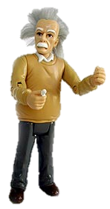
Mechanical Energy Conversions
Max. GPE
Min. KE
GPE = ↓
KE = ↑
Min. GPE
Min. KE

Slide 12
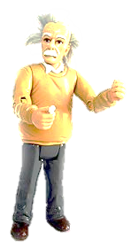
Mechanical Energy Conversions
Max. GPE
Min. KE
Max. GPE
Min. KE
GPE = ↓
KE = ↑
GPE = ↑
KE = ↓
Min. GPE
Max. KE
Min. GPE
Max. KE

Slide 13
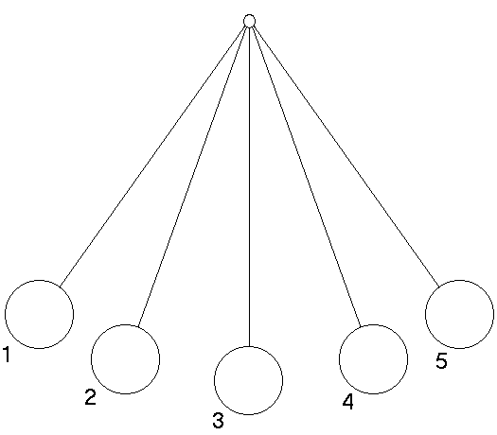
Mechanical Energy Conversions
Imagine a pendulum swinging left to right…
Where is the KE at its maximum?
3…the bottom of its swing is where the pendulum moves fastest.
Where is the GPE at its maximum?
1 & 5…the top of its swing is where it has the greatest height.
Where does it have BOTH KE and GPE?
2 & 4…height with motion

