Slide 1
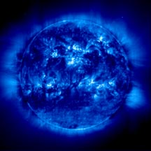
The Electromagnetic Spectrum

Slide 2
Electromagnetic Waves
Consist of an oscillating (moving back and forth) electric field and an oscillating magnetic field.
Think of it as two waves at a right angle to each other who share an origin.

Slide 3
The Electromagnetic Spectrum
Electromagnetic waves are classified based on their wavelengths
As waves decrease in wavelength, they increase in energy

Slide 4
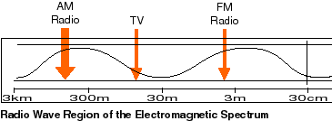
Radio Waves
Have the longest wavelength in the spectrum
Can be as long as a football field or as short as a football
Cell Phones, Radios, TV Antennae

Slide 5
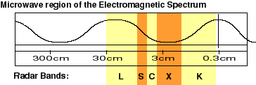
Microwaves
Can be measured in centimeters
The ones used to heat our food are about a foot in wavelength
Microwaves, Radar

Slide 6
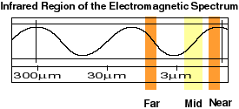
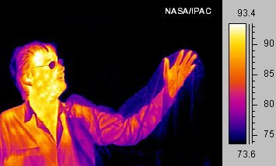
Infrared Waves
Wavelengths range from about the size of a pinhead to the size of cells (millimeters to micrometers)
Remote Controls, Body Heat

Slide 7
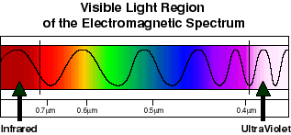
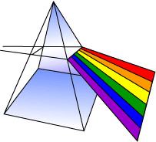
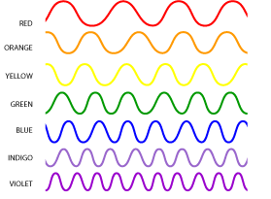
Visible Light
These are the only electromagnetic waves we can see.
White light contains all colors
Color depends on wavelength

Slide 8
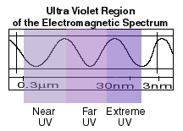
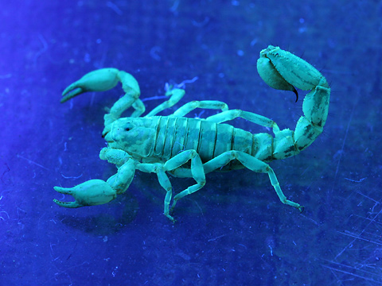
Ultraviolet Waves
Invisible to humans
Bumble Bees can see UV light
UV rays are responsible for sunburns
Some chemicals fluoresce under ultraviolet light

Slide 9
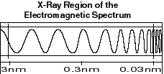
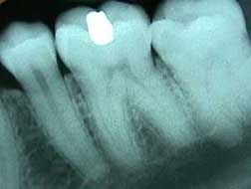
X-Rays
X-ray light has very small wavelengths (1,000,000,000 nanometers in a meter)
X-Ray images can help us see objects with more density (your bones are more dense than your skin)

Slide 10
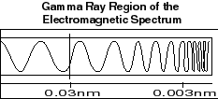
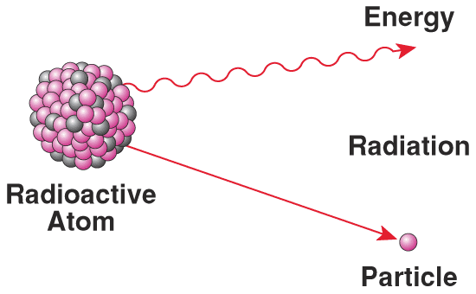
Gamma Rays
Generated by radioactive atoms
Used to help us date the age of objects
Radioactive Decay

Slide 11
NASA website on E/M Spectrum
http://science.hq.nasa.gov/kids/imagers/ems/index.html

