Slide 1
The Sun And Earth

Slide 2
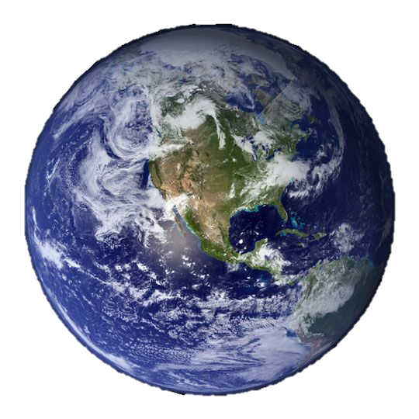
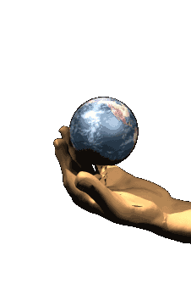
Earth’s Shape
Earth is SPHERICAL
“BALL-SHAPED”
How do we know?

Slide 3
Earth is a sphere

Slide 4
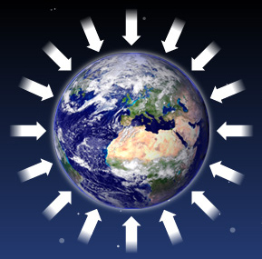
Earth is a sphere
Why is Earth spherical?
GRAVITY
Earth’s gravity pulls its mass towards its center from all directions

Slide 5
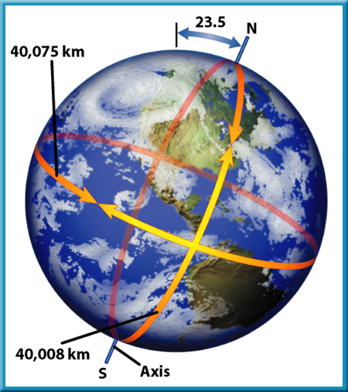
Not quite a “perfect” sphere…
Earth has a slight “bulge” at the equator
Centrifugal Force due to its rotation
Longer around equator than poles

Slide 6
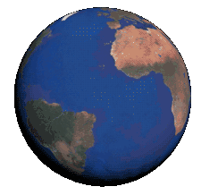
Earth’s rotation
1 DAY is the time it takes the EARTH to complete a full ROTATION around its axis
24 hours
This explains why the SUN “rises” and “sets”

Slide 7
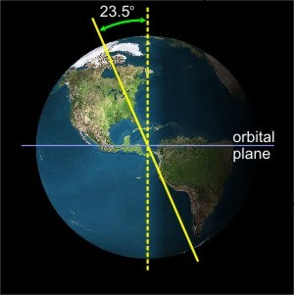
Earth’s rotation
Earth’s rotational axis is tilted 23.5% from its orbital plane
Earth does not ROTATE along the same plane on which it REVOLVES

Slide 8
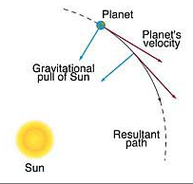
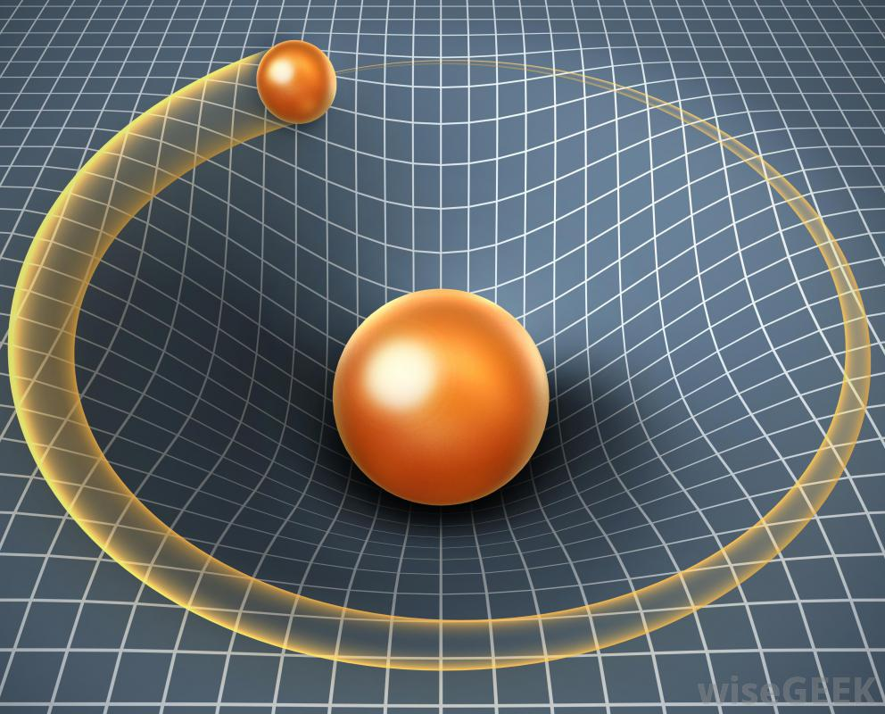
Earth’s Revolution
Earth ORBITS the Sun because of the Sun’s GRAVITATIONAL PULL

Slide 9
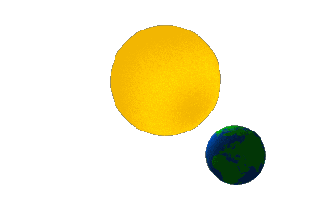
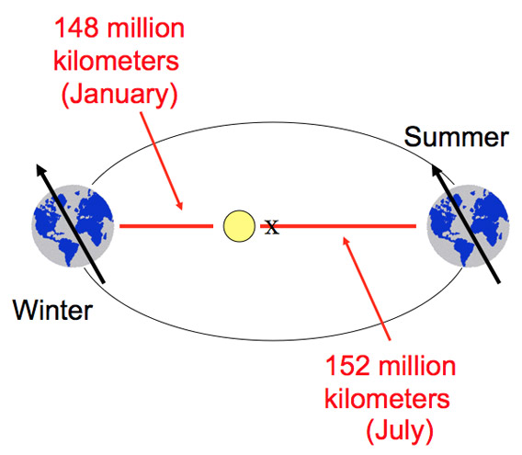
Earth’s Revolution
1 YEAR is the time it takes the EARTH to complete one full REVOLUTION around the SUN (365.25 days)
Elliptical orbit
SUN at one focal point

Slide 10
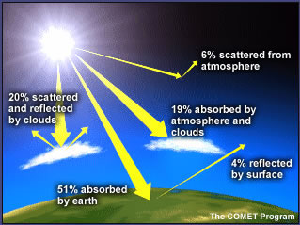
Energy from the Sun
Earth receives energy from the Sun
THERMAL ENERGY - heat
RADIANT ENERGY - light

Slide 11
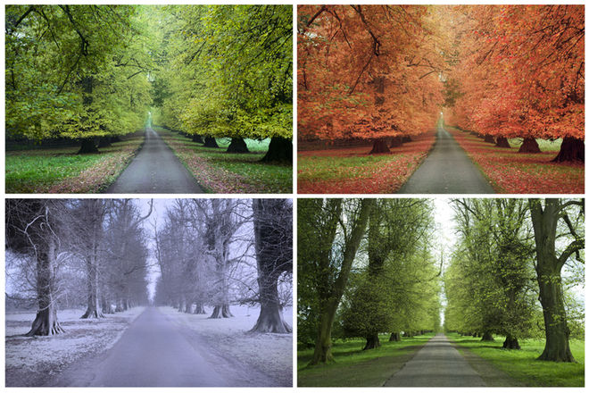
Earth’s seasons
Earth’s tilt causes the distribution of the Sun’s energy to change throughout the year.
This creates
“SEASONS”

Slide 12
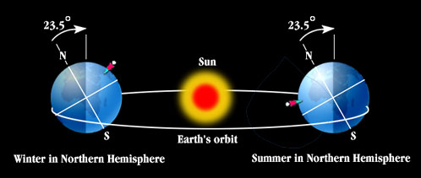
Earth’s Seasons
SUMMER where there is DIRECT sunlight
Longer Days & Higher Temperatures
WINTER where there is INDIRECT sunlight
Shorter Days & Lower Temperatures

Slide 13
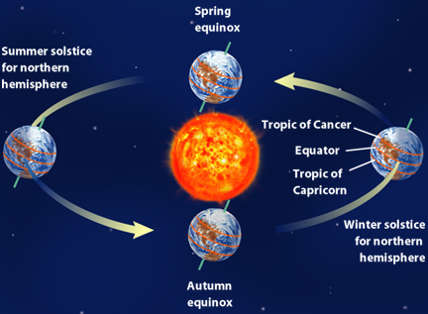
Earth’s Seasons
SOLSTICE
Earth tilted toward/away from Sun
Longest/shortest days
EQUINOX
Sun is directly above EQUATOR
12 hours of light & dark

Slide 14
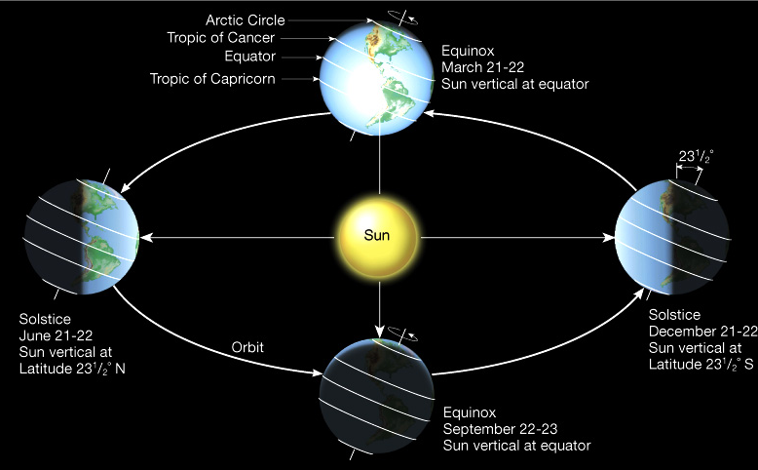
Solstice & equinox

Slide 15
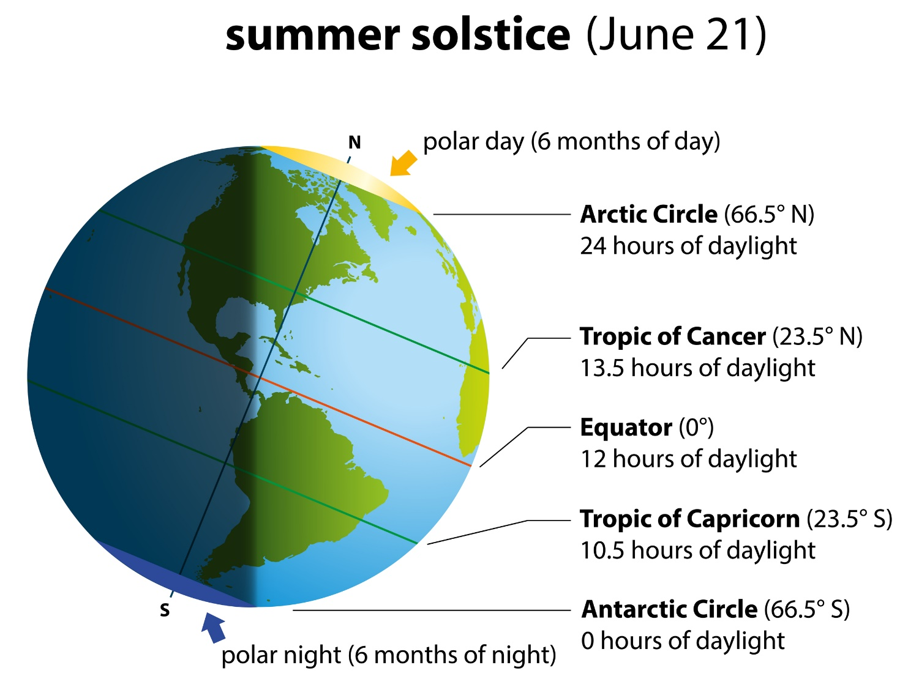
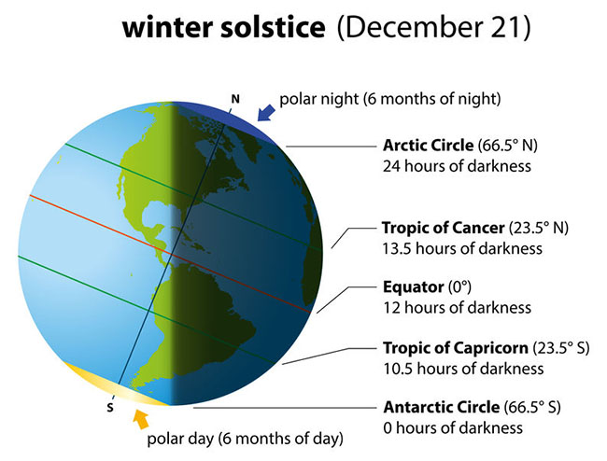
Solstices
Longest & shortest days (daylight hours) of the year (note: the tropics shown in these diagrams are not at the correct latitudes.)

